Slide 1
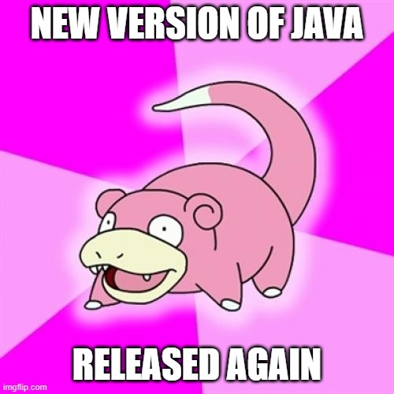
Java 15: what’s new
*Release was on the 15th of September, 2020

Slide 2
My previous talk about Java14 can be found here:
https://github.com/akuleshov7/my-conference-presentations/tree/master/Java14

Slide 3
Let’s refresh
Changes in Java distribution
How it affects me?

Slide 4


Any difference?
no real technical difference
build process for the Oracle JDK is based on OpenJDK.
Can be used in PROD for free
Performance is good enough for PROD
6 months of support
Should pay for commercial license
Performance is better
LTS (5 years)

Slide 5
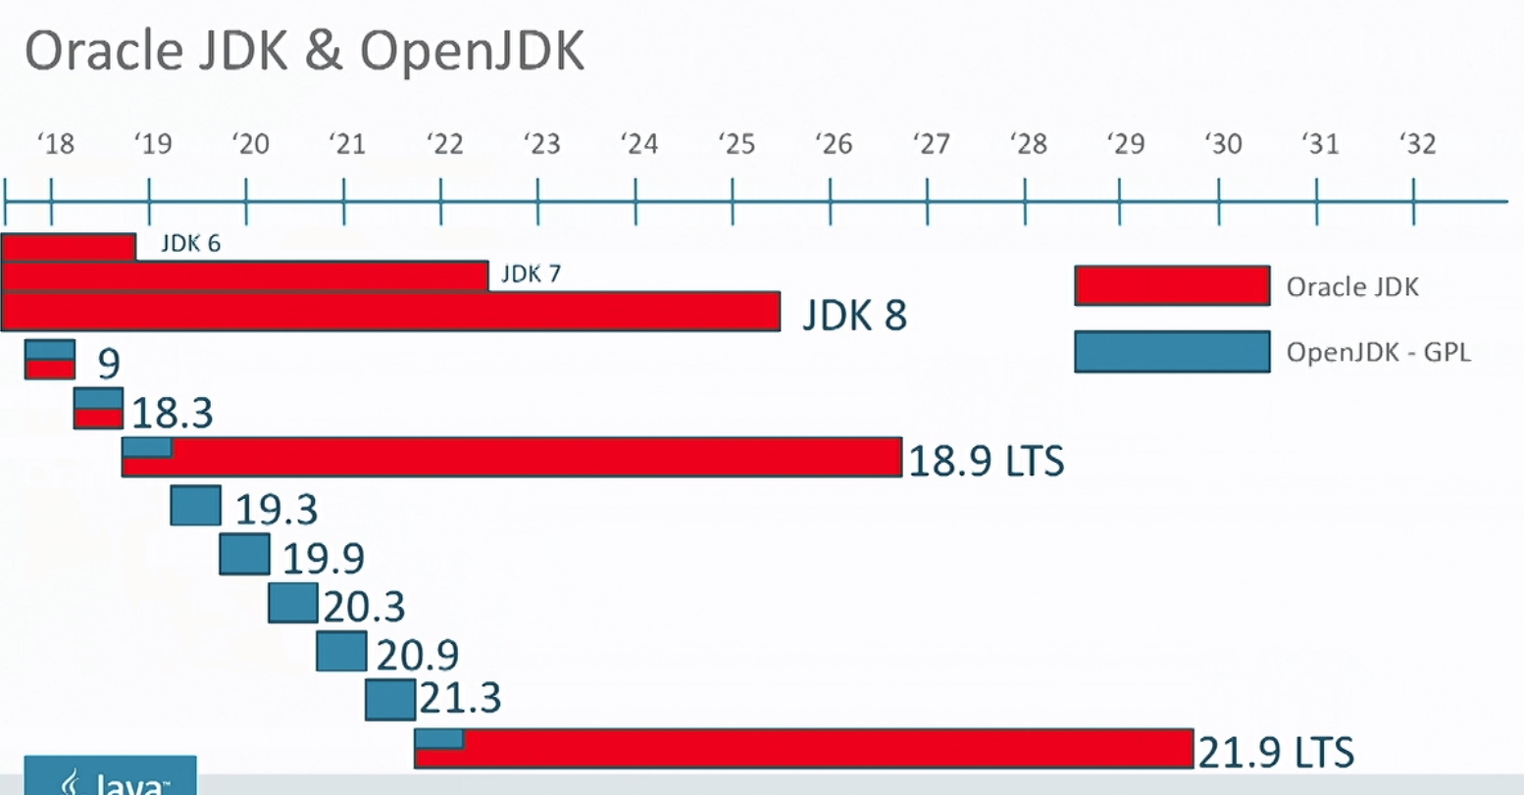
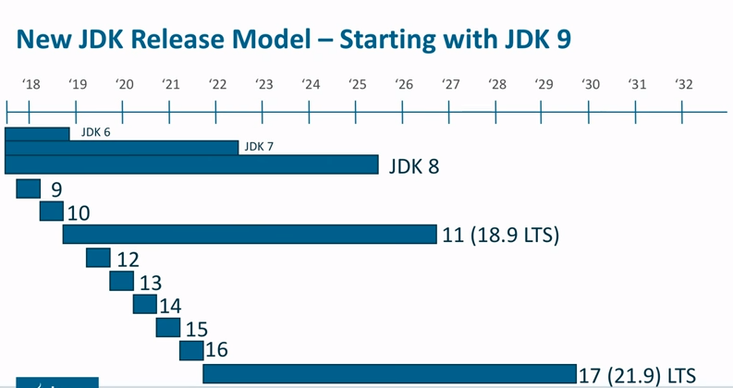
Release cycle

Slide 6
Some vocabular
JEP
JSR
Commitee
JCP
JDK Enhancement Proposal
(informal JCP)
Java Specification Request
Best representatives from the best companies. Rotation each year.
Java Community Process
Notes:
:

Slide 7
JEP-12: Preview features
A preview feature is a new feature of Java language, that is fully specified, fully implemented, and yet impermanent. Provokes developer feedback based on real world use. Can become permanent in the future.
For example in Java 11 we had experimental options:
-XX:+UnlockExperimentalVMOptions -XX:+UseZGC

Slide 8
Finally! Let’s move to features of Java15
Brief overview

Slide 9
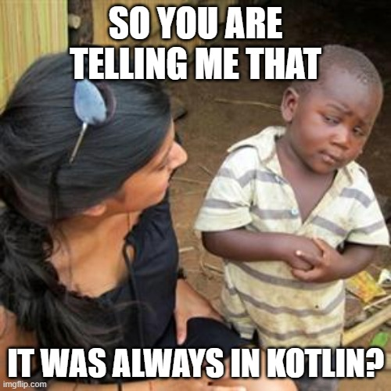
Disclaimer
My Huawei project diKTat was added to Kotlin-awesome list, so I will criticize Java and will love Kotlin.
Please forgive me ☺

Slide 10
Language features
1
Features that 99% of you can and will use

Slide 11
JEP-360
Sealed classes!

Slide 12


JEP-360: Sealed classes (Enums on steroids)
Preview feature (-enable-preview -release 15)
New syntax in language that came from Scala/Kotlin
Described: https://openjdk.java.net/jeps/360

Slide 13
JEP-360: Sealed classes (Enums on steroids)
New modifiers for classes and interfaces: “sealed/non-sealed”
New keyword “permits”

Slide 14
JEP-360: Sealed classes (Enums on steroids)
New modifiers for classes and interfaces: “sealed/non-sealed”
New keyword “permits”
Asserts control over which other types may be its subclasses

Slide 15
JEP-360: Sealed classes (Enums on steroids)
New modifiers for classes and interfaces: “sealed/non-sealed”
New keyword “permits”
Asserts control over which other types may be its subclasses
A sealed class or interface can be extended or implemented only by
those classes and interfaces permitted to do so.

Slide 16
JEP-360: Sealed classes (Enums on steroids)
New modifiers for classes and interfaces: “sealed/non-sealed”
New keyword “permits”
Asserts control over which other types may be its subclasses
A sealed class or interface can be extended or implemented only by
those classes and interfaces permitted to do so.
Extremely needed in switch statements and pattern matching
Works nice with records (data classes)

Slide 17
JEP-360: how it works
sealed interface Shape permits Rectangle, Circle {}

Slide 18
JEP-360: how it works
sealed interface Shape permits Rectangle, Circle {}
record Rectangle(int width, int height) implements Shape {} record Circle(int radius) implements Shape {}

Slide 19
JEP-360: limitations
Sealed class/interface should stay in the same file with inheritors
(if permits keyword was not used)
Inherited classes should be only sealed/non-sealed/final

Slide 20
JEP-360: limitations
Sealed class/interface should stay in the same file with inheritors
(if permits keyword was not used)
Inherited classes should be only sealed/non-sealed/final
Inherited classes with permit keyword should stay in the same module
Local classes (anonymous classes) cannot be inherited from sealed

Slide 21
JEP-360: examples
public sealed interface Shape permits Rectangle {} record Rectangle(int width, int height) {} // not implemented interface
$ java: invalid permits clause (subclass Rectangle must extend sealed class)

Slide 22
JEP-360: examples
public sealed interface Shape permits Rectangle {} record Rectangle(int width, int height) {} // not implemented interface
$ java: invalid permits clause (subclass Rectangle must extend sealed class)
public sealed interface Shape {} // no inheritors/implementations
$ java: sealed class must have subclasses

Slide 23

JEP-360: future
This feature is made to support pattern matching, that is still not finished!
https://openjdk.java.net/jeps/8213076

Slide 24
JEP-360: future
This feature is made to support pattern matching, that is still not finished!
https://openjdk.java.net/jeps/8213076
It should work in the following way (like in Scala/Kotlin):
sealed interface Color permits BiColor, TriColor { } record BiColor(int r, int g, int b) implements Color {} record TriColor(int r, int g, int b) implements Color {}
// … void foo(Color color) { switch (color) { case BiColor i -> 0; case TriColor j ->1; } }

Slide 25
JEP-339
Edwards-Curve Digital Signature Algorithm

Slide 26

JEP-339: Edwards-Curve Digital Signature
Crypto algorithm of digital signature (standard RFC 8032)
Description: https://openjdk.java.net/jeps/339
Security and crypto developers say it is one of the main features of Java15 ☺

Slide 27
JEP-375
Pattern matching (second preview)

Slide 28

JEP-375: Pattern matching for instanceof
Preview feature (-enable-preview -release 15)
This is just a second preview
And still it is not a NORMAL pattern matching
Description: http://openjdk.java.net/jeps/375
New syntax in language, but no changes from Java14.

Slide 29
JEP-375 : Pattern matching for instanceof
Before Java 14
Object obj = "Ivan loves instanceof"; if (obj instanceof String) { String s = (String) obj; System.out.println(s.length()); }

Slide 30
JEP-375: Pattern matching for instanceof
After Java 14
Object obj = "Ivan loves instanceof";
if (obj instanceof String s){ System.out.println(s.length()); }

Slide 31
JEP-384
Records (second preview)

Slide 32

JEP-384: Records (aka data classes)
Preview feature (-enable-preview -release 15)
Part of Valhalla Project
New syntax in language
Description: https://openjdk.java.net/jeps/384

Slide 33
JEP-384: what has changed from Java14
Now the JEP explicitly prohibits declaring native methods in records.

Slide 34
JEP-384: what has changed from Java14
Now the JEP explicitly prohibits declaring native methods in records.
The implicitly declared fields corresponding to the record components
of a record class are final and should not be modified via reflection

Slide 35
JEP-384: what has changed from Java14
Now the JEP explicitly prohibits declaring native methods in records.
The implicitly declared fields corresponding to the record components
of a record class are final and should not be modified via reflection
Records can also be defined within methods to store intermediate values. Unlike local classes, a local record is implicitly static.

Slide 36

JEP-384: Records (aka data classes)
public record Person(String name, String surname){}
All needed methods are generated by compiler
Final, cannot be abstract

Slide 37
JEP-384: Records (aka data classes)
public final class Person extends java.lang.Record { private final java.lang.String name; private final String surname; public Person(java.lang.String name, String surname) { /* compiled code */ } public java.lang.String toString() { /* compiled code */ } public final int hashCode() { /* compiled code */ } public final boolean equals(java.lang.Object o) { /* compiled code */ } public java.lang.String name() { /* compiled code */ } public String surname() { /* compiled code */ } }

Slide 38
JEP-378
Text blocks finally released!

Slide 39

JEP-378: Text Blocks (released)
Added some changes to JEP-378: Text Blocks (Preview)
Will be different from the Java 13 version, but same as in Java 14
Finally released after second review

Slide 40
JEP-368: Text Blocks (Second Preview)
Before Java 13
String html = "<html>\n" + " <body>\n" + " <p>Hello, world</p>\n" + " </body>\n" + "</html>\n";

Slide 41
JEP-368: Text Blocks (Second Preview)
In Java 13
String html = """ <html> <body> <p>Hello World</p> </body> </html> """;

Slide 42
JEP-368: Text Blocks (Second Preview)
After Java 15 (by the default )
String text = """ Here I want spaces in the end not being trimmed: \ Here I will use the second version of this feature: \s This will work? Nice! """;
\ - added for newline
\s – added for explicit space

Slide 43
JEP-371
Hidden Classes

Slide 44
JEP-371: Hidden classes
Hidden classes - cannot be used directly by the bytecode of other classes
Intended for use by frameworks that generate classes at run time
and use them indirectly, via reflection

Slide 45
JEP-371: Hidden classes
Hidden classes - cannot be used directly by the bytecode of other classes
Intended for use by frameworks that generate classes at run time
and use them indirectly, via reflection
Change in Java API, no language changes
Description: https://openjdk.java.net/jeps/371

Slide 46
JEP-371: Hidden classes
ClassLoader::defineClass and Lookup::defineClass
No difference if the class were generated at run time or at compile time

Slide 47
JEP-371: Hidden classes
ClassLoader::defineClass and Lookup::defineClass
No difference if the class were generated at run time or at compile time
But Lookup::defineHiddenClass solves this issue

Slide 48
Tools and libs
2
Features that 10% of you will use, speedrun

Slide 49
JEP-378
ZGC

Slide 50
JEP-378: Z garbage collector
Now it is a default GC in Java
Scalable low latency garbage collector

Slide 51
JEP-378: Z garbage collector
Now it is a default GC in Java
Scalable low latency garbage collector
Max pause times of a few milliseconds (stop the world)

Slide 52
JEP-378: Z garbage collector
Now it is a default GC in Java
Scalable low latency garbage collector
Max pause times of a few milliseconds (stop the world)
Pause times do not increase with the heap or live-set size
Handle heaps ranging from a 8MB to 16TB in size

Slide 53
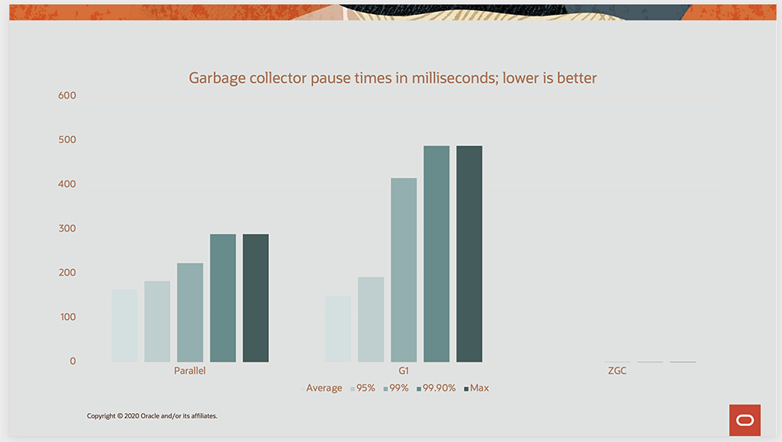
JEP-378: Z garbage collector

Slide 54
JEP-379
Shenandoah GC

Slide 55
JEP-379: Shenandoah GC
Now it is enabled as production feature
Performing more garbage collection work concurrently with the running Java program

Slide 56
JEP-379: Shenandoah GC
Now it is enabled as production feature
Performing more garbage collection work concurrently with the running Java program
Shenandoah does the bulk of GC work concurrently
Pause times are no longer directly proportional to the size of the heap
Created by Russian Java-Champion A. Shipilev

Slide 57
Things that you will not even notice
3
Features that 0% of you will notice

Slide 58
You won’t notice it
JEP 372: Remove the Nashorn JavaScript Engine
JEP 374: Disable and Deprecate Biased Locking
JEP 381: Remove the Solaris and SPARC Ports
JEP 385: Deprecate RMI Activation for Removal
JEP 373: Reimplement the Legacy DatagramSocket API

Slide 59
NO
Java language features are still much weaker than Kotlin and Scala

Slide 60

Thanks!
DO YOU HAVE ANY QUESTIONS?

